Slide 1
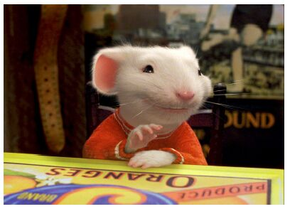
CSE- 4105
Lecture- 14
Mid Point Ellipse

Slide 2
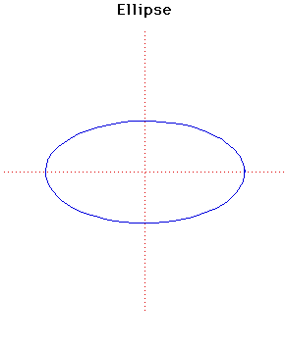
Ellipse-Generating Algorithms
In mathematics, an ellipse is a curve on a plane surrounding two focal points such that the sum of the distances to the two focal points is constant for every point on the curve.
b
-a
a
-b
Notes:
‹#›

Slide 3
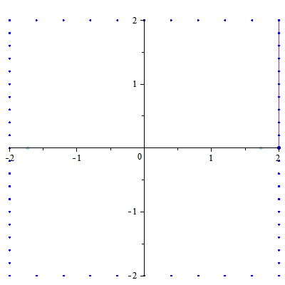
Ellipse-Generating Algorithms

Slide 4
Ellipse-Generating Algorithms
Ellipse – A modified circle whose radius varies from a maximum value in one direction (major axis) to a minimum value in the perpendicular direction (minor axis).
The sum of the two distances d₁ and d₂, between the fixed positions F₁ and F₂ (called the foci of the ellipse) to any point P on the ellipse, is the same value, i.e.
d₁ + d₂ = constant
d₁
F₁
P=(x,y)
F₂
d₂
Notes:
‹#›

Slide 5
Ellipse Properties
Expressing distances d₁ and d₂ in terms of the focal coordinates F₁ = (x₁, x₂) and F₂ = (x₂, y₂), we have:
d₁
F₁
P=(x,y)
F₂
d₂
Notes:
‹#›

Slide 6
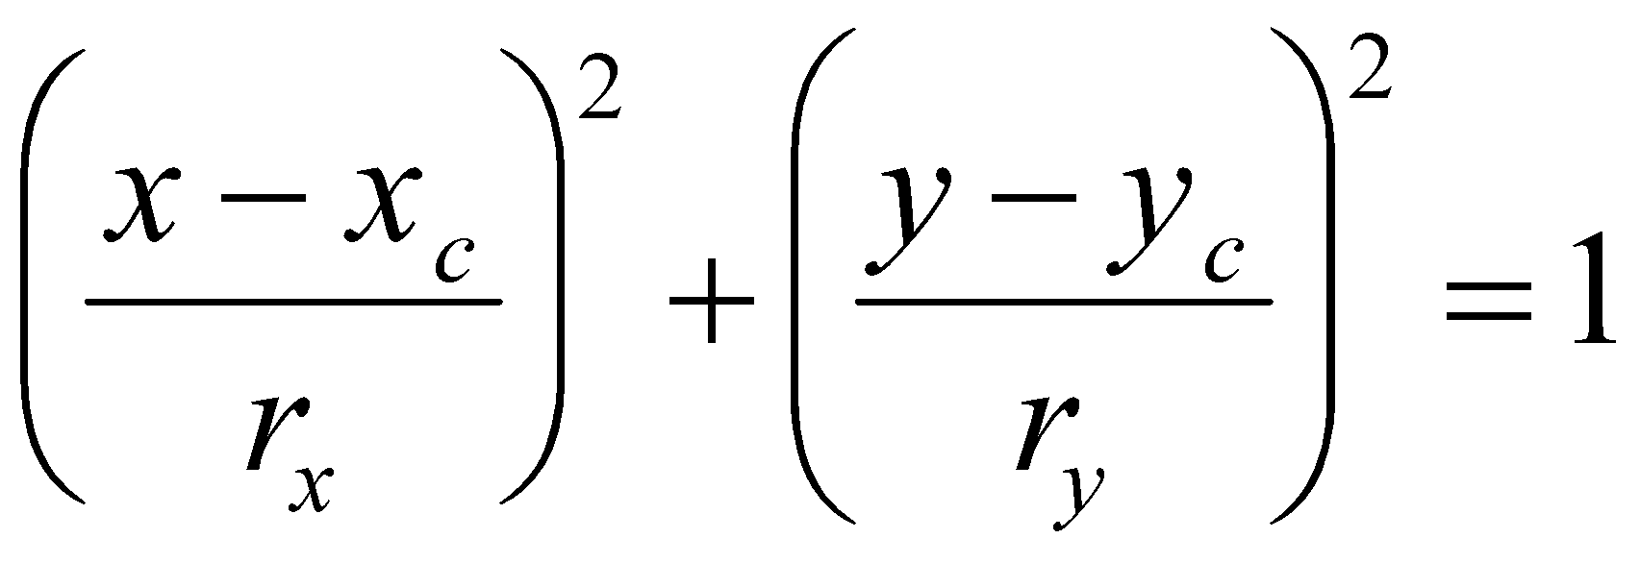
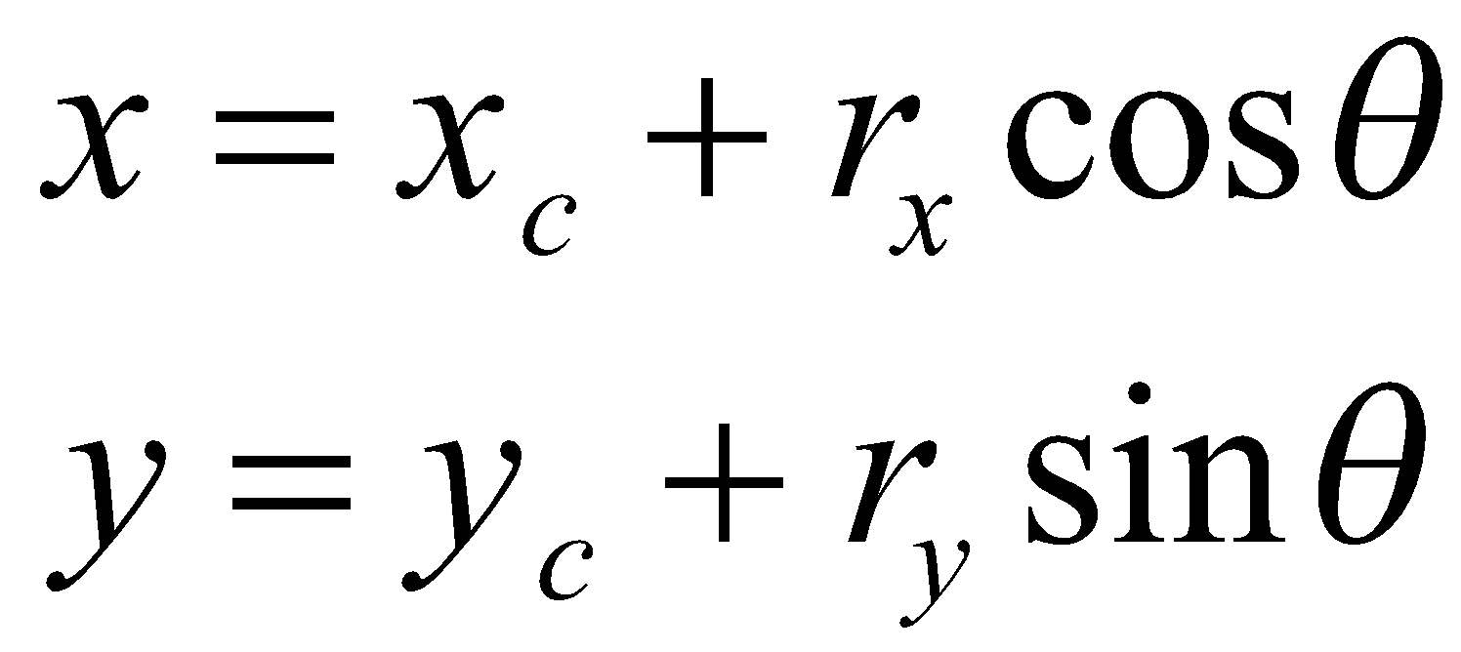
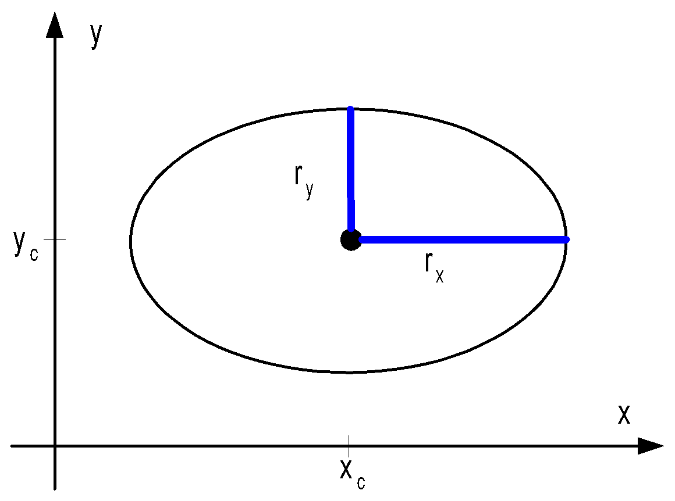
Ellipse-Generating Algorithms
Equation simplified if ellipse axis parallel to coordinate axis
Parametric form
Notes:
‹#›

Slide 7
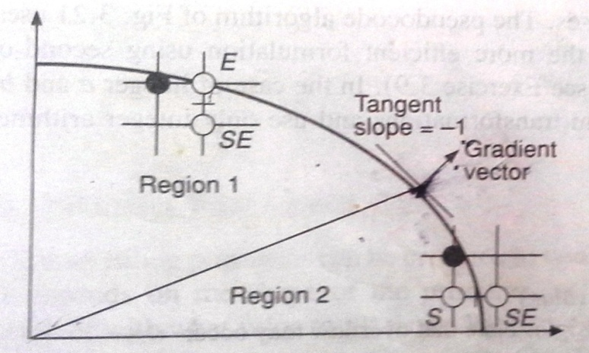
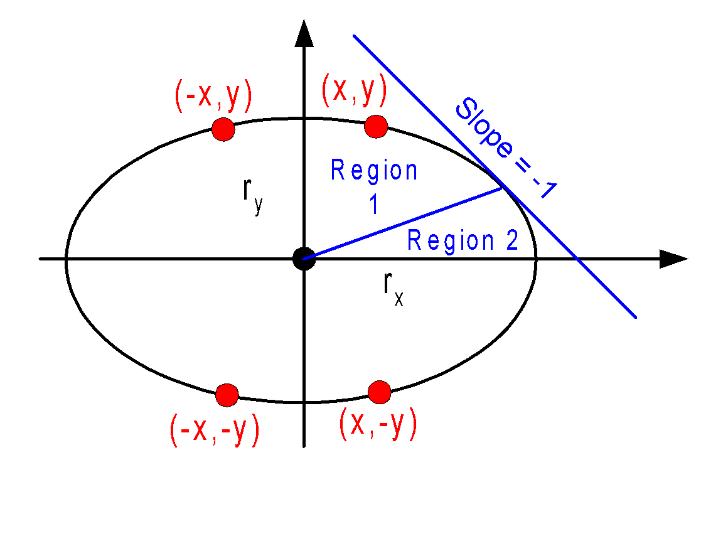
Symmetry Considerations
Ellipse-Generating Algorithms
4-way symmetry
Notes:
‹#›

Slide 8
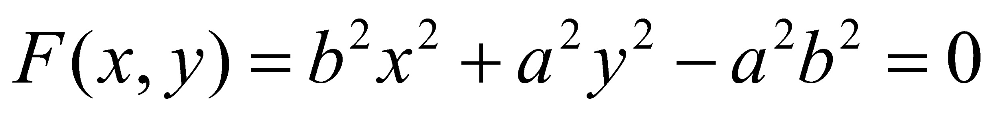
Ellipse Algorithms
Consider a ellipse, centered at(0,0)
2a is the length of major axis, 2b is the length of major axis
b
-a
a
-b

Slide 9
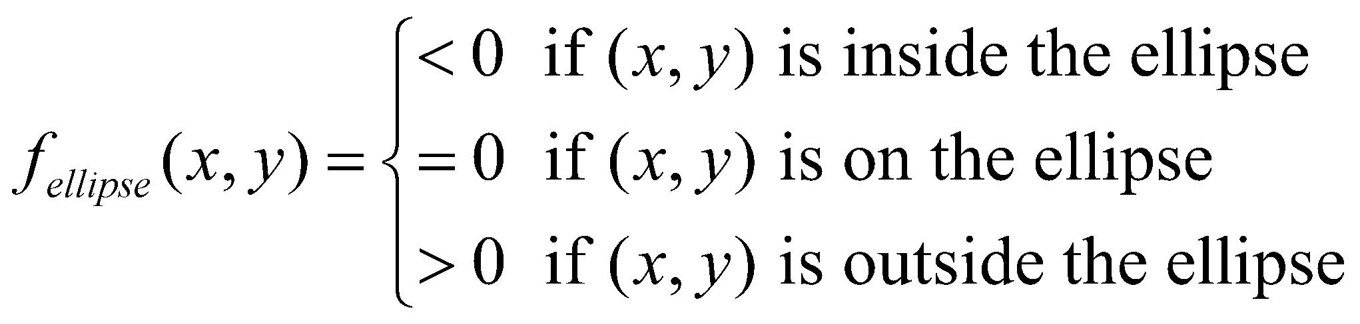
Ellipse Algorithms
Decision parameter:

Slide 10
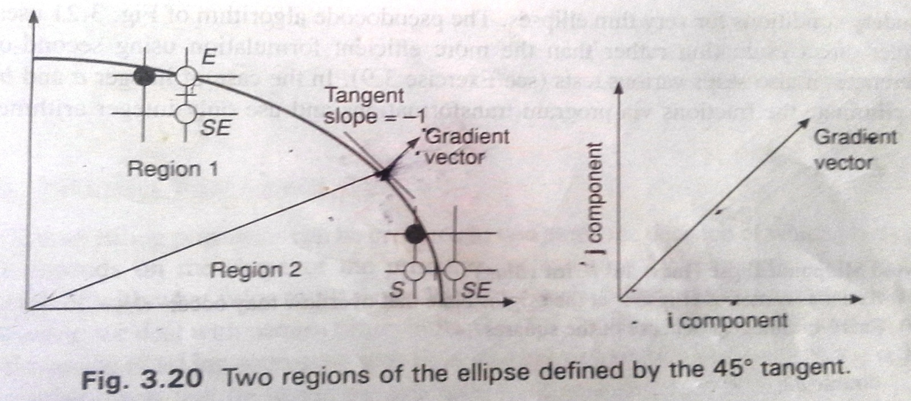
Symmetry Considerations
Ellipse-Generating Algorithms
We divide the quadrant into two region
Find the point at which the curve has a slope -1.
Complex.
Notes:
‹#›

Slide 11
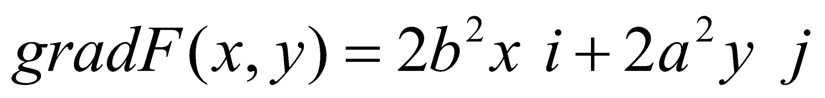
Scan converting ellipses
The vector perpendicular to the tangent to the curve at point P(x,y) is called gradient.
Differentiate the equation.

Slide 12
Scan converting ellipses
The point occurs when the gradient vector has a slop 1
When i and j component of the gradient is equal magnitude then
In region 1:
The j component of the gradient is larger
In region 2:
The i component of the gradient is larger

Slide 13

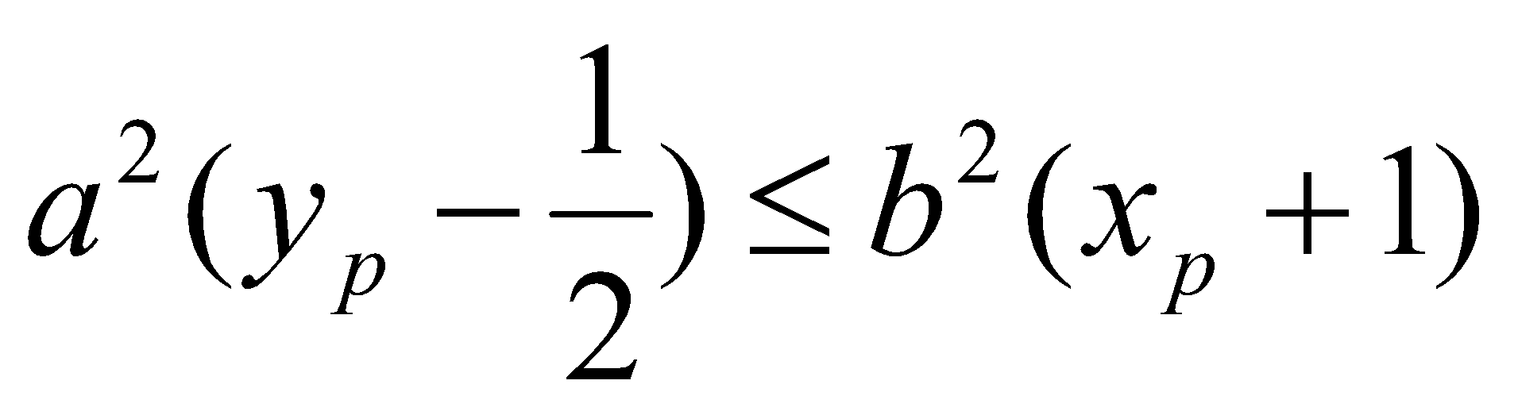
Scan converting ellipses
So we switch from region 1 to region 2
if the next midpoint,
The point occurs when the gradient vector has a slop 1
When i and j component of the gradient is equal magnitude then
In region 1:
The j component of the gradient is larger
In region 2:
The i component of the gradient is larger

Slide 14
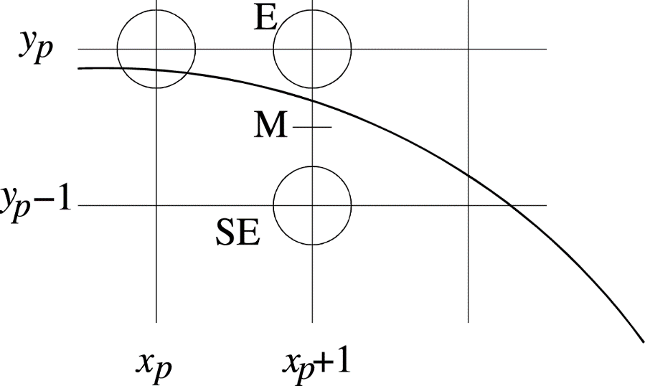
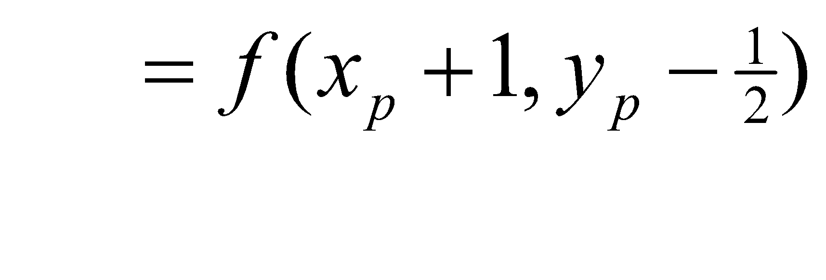


Making a Decision
Scan converting ellipses- region 1
Computing the decision variable D
If then M is below the arc, hence the E pixel is closer to the line.
If then M is above the arc, hence the SE pixel is closer to the line.
Notes:
‹#›

Slide 15
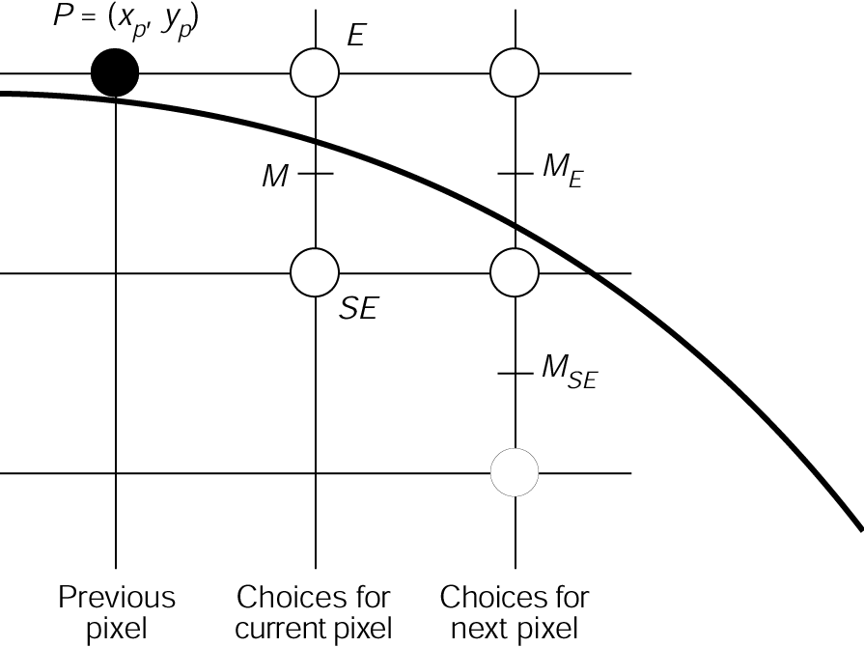
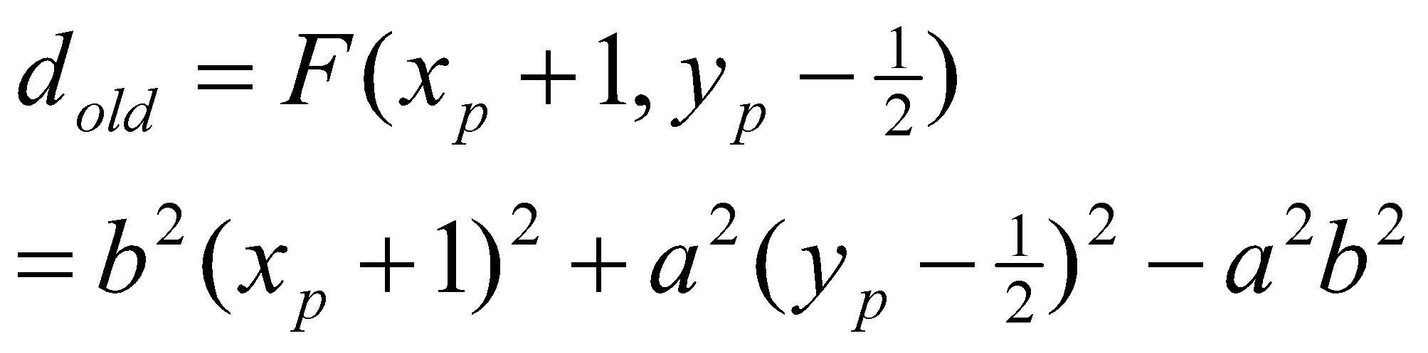
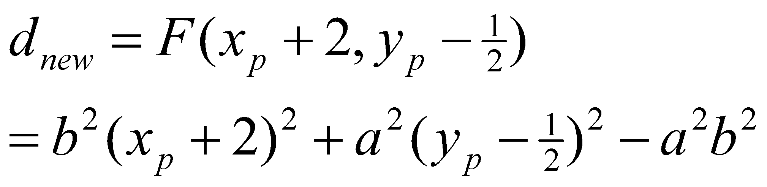
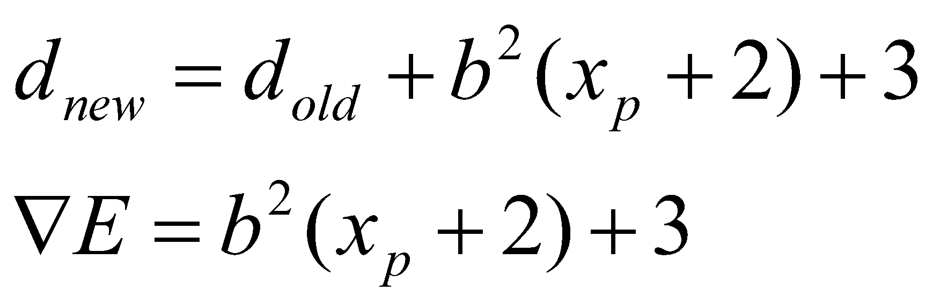
Computing the Increment-region 1
E case
So…
Notes:
‹#›

Slide 16
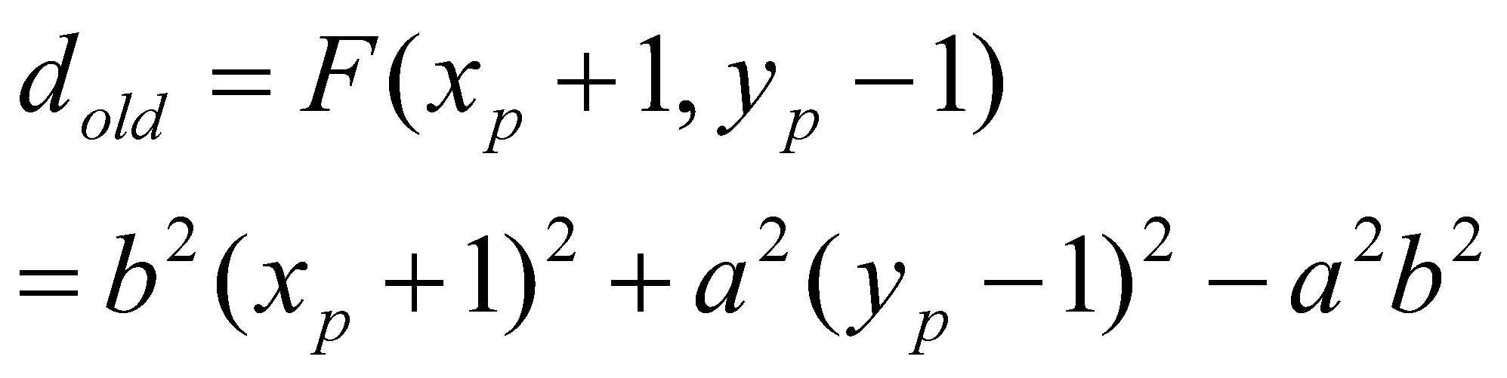
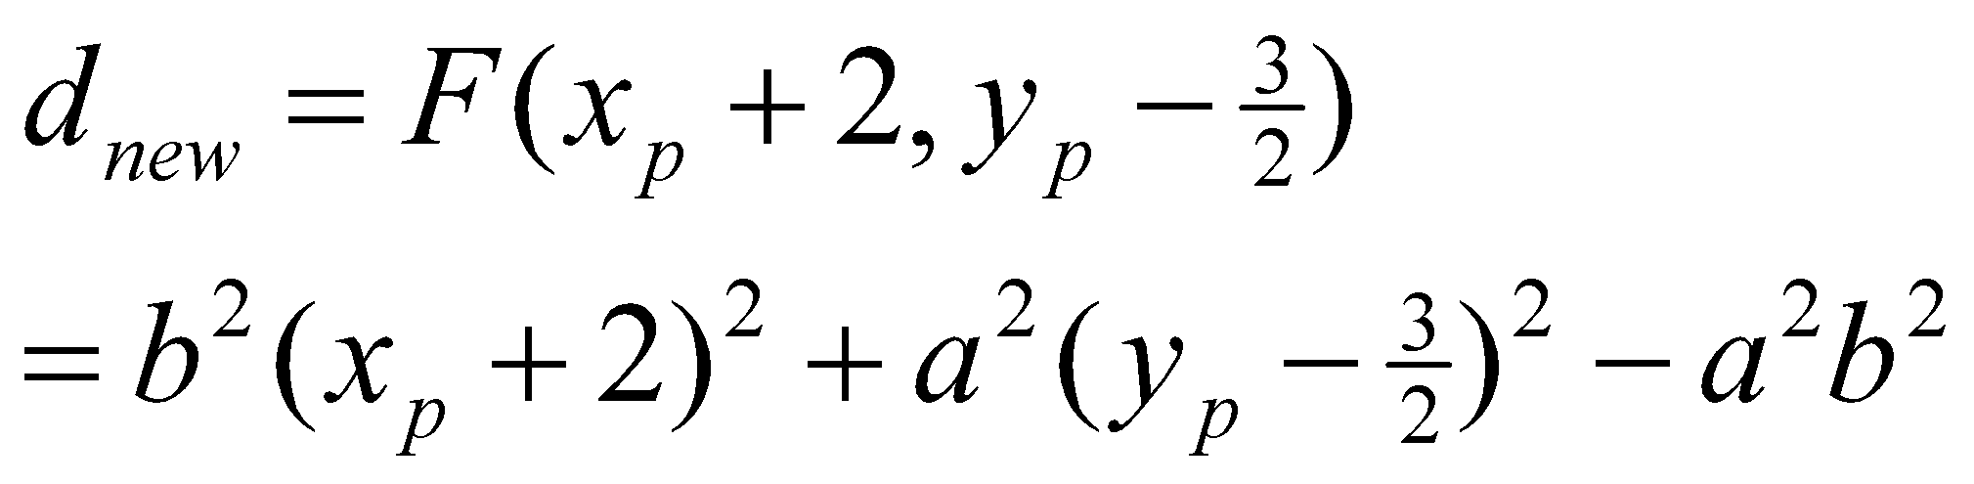
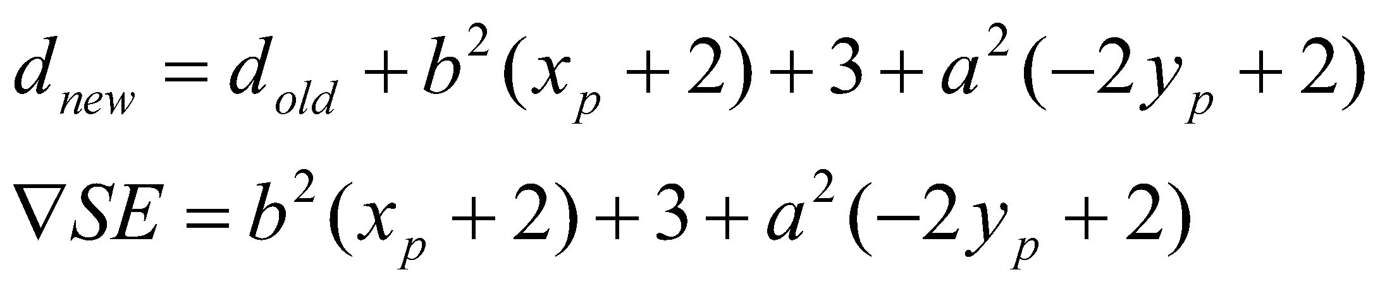
Computing the Increment-region 1
SE case
So…
Notes:
‹#›

Slide 17
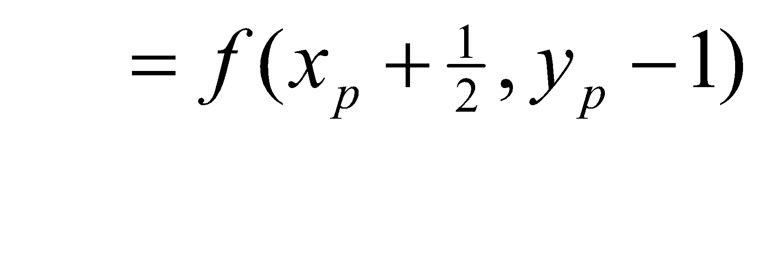
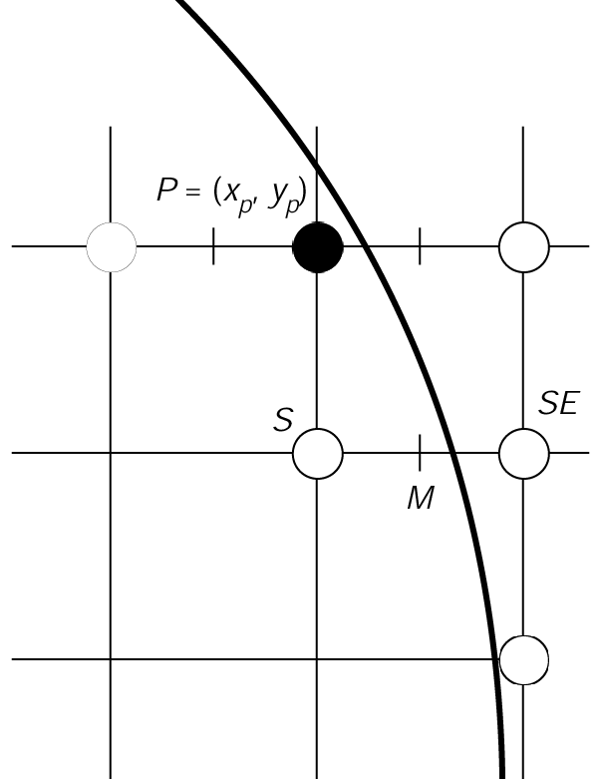
Making a Decision
Scan converting ellipses- region 2
Computing the decision variable D
If then M is left of the arc, hence the SE pixel is closer to the line.
If then M is right of the arc, hence the S pixel is closer to the line.
1994 Foley/VanDam/Finer/Huges/Phillips ICG
Notes:
‹#›

Slide 18
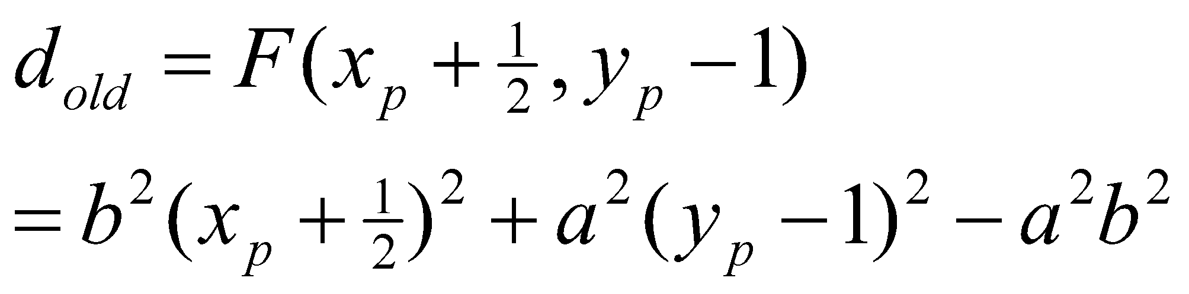
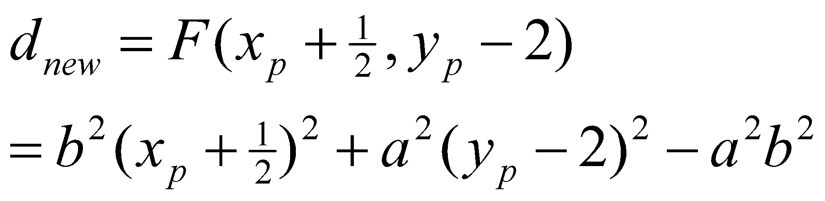
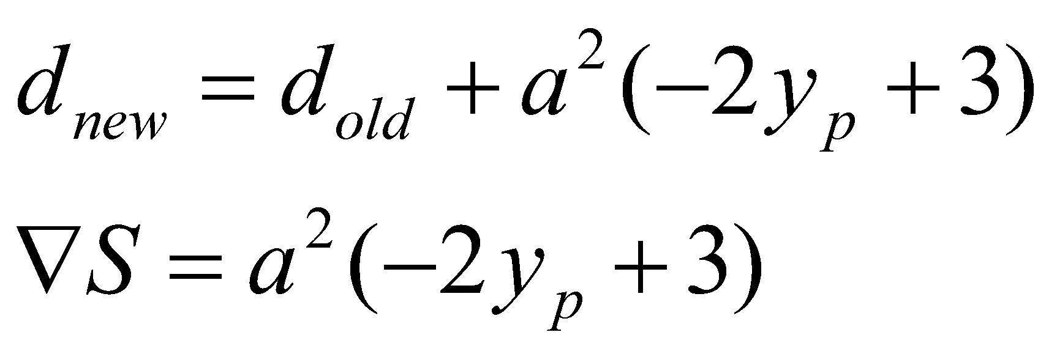
Computing the Increment-region 1
S case
So…
Notes:
‹#›

Slide 19
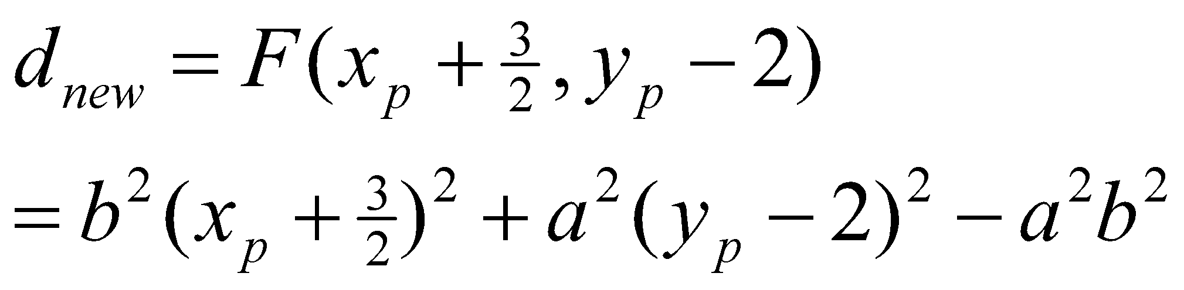
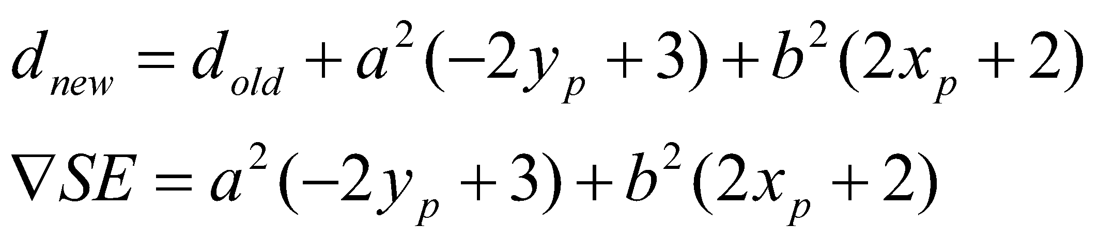
Computing the Increment-region 1
SE case
So…
Notes:
‹#›

Slide 20
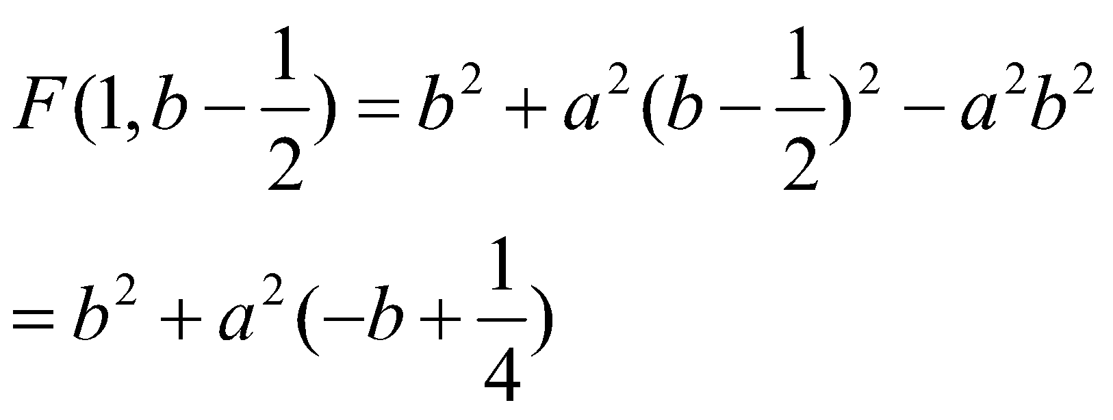
Initial value-region 1
Initial value-let the ellipse started at (0,b)

Slide 21
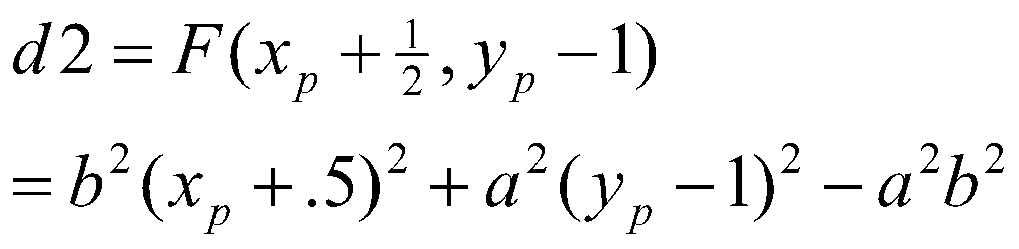
Initial value-region 2
Initial value-
We stop drawing in region 2 when
value of the pixel is equal to 0

Slide 22
Algorithm
See Book page number:114

Slide 23
Thank You

